Slide 1
HINF 140
Week 5:
Presentation 5B

Slide 2
Health Care Practitioners and Workplace Settings

Slide 3
Learning Outcomes
5.1 Describe the various ways in which individuals working in health care are categorized
5.2 Outline the purpose and benefits of regulated health professions.
5.3 Discuss the role and educational requirements of various health care professionals.
5.4 Describe practice settings in which health care is delivered.
5.5 Summarize the current state of primary care in Canada primary care.

Slide 4
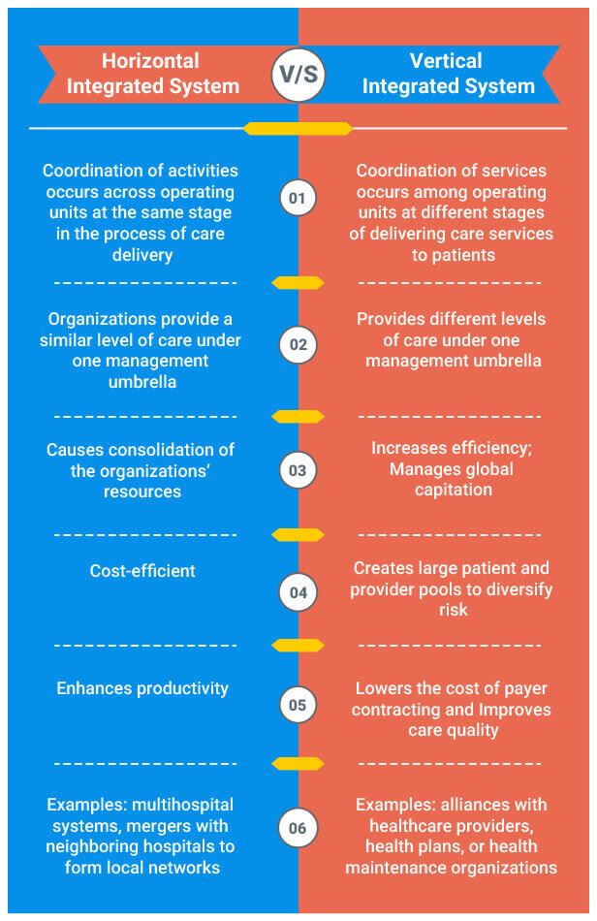
Horizontal vs Vertical Integration

Slide 5

Regulation of Health Care Professions
Educational standards
Provincial and territorial examinations
Practitioner’s scope of practice, which outlines skills, acts, and services the practitioner is able to perform competently and safely
Curbing of individual’s practice if standards are not met
Formal complaints process for the public
Complaints investigation and follow-up
Title protection
Competence and quality assurance

Slide 6
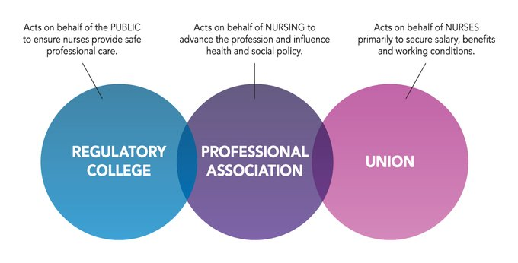

Slide 7

Performing Controlled Acts
Controlled acts, if not performed by a qualified practitioner, may result in harm to a patient
Reserved acts in BC
Controlled acts are identified by the Regulated Health Professions Act (RHA) or the equivalent in each jurisdiction
Examples of controlled acts include
Giving an injection
Setting or casting a fracture
Passing a nasogastric tube
Prescribing a medication

Slide 8

Exceptions
Most provinces and territories allow controlled acts to be performed by competent yet unregulated individuals, including
A person with appropriate training providing first aid or assistance in an emergency
Students learning to perform an act under the supervision of a qualified person
A person, such as a caregiver, trained to perform an act (e.g., giving injections to a person with diabetes)
An appropriate person designated to perform an act in accordance with a religion

Slide 9
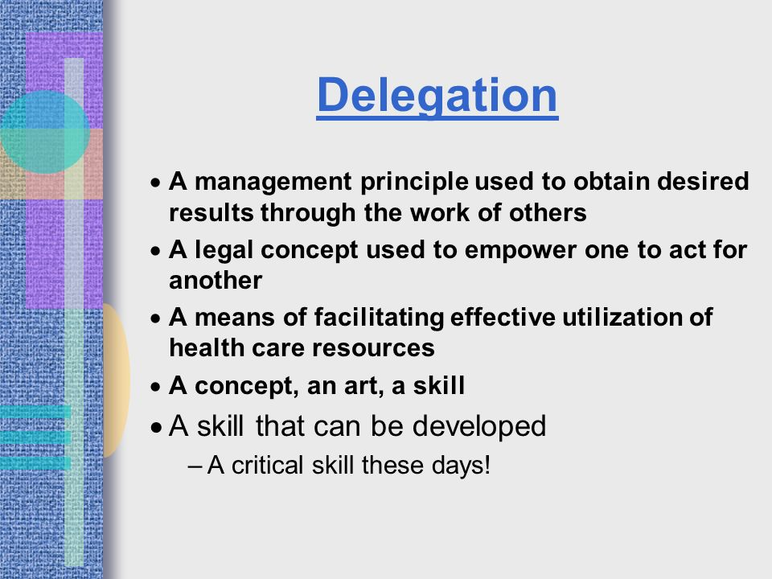
Delegated Acts (1 of 2)
A delegated act by definition is the means by which a regulated health professional (authorized to perform the delegated act) transfers legal authority or permits another person to carry out a controlled act they are otherwise unauthorized to do (procedures that are not controlled acts do not require delegation)

Slide 10

Delegated Acts (2 of 2)
Although guidelines and protocols for delegation of medical acts vary across Canada, in general the delegated act must be clearly defined and supervised accordingly
The delegating health care professional, the delegate, the facility, or environment in which the act is performed share responsibility for the act

Slide 11
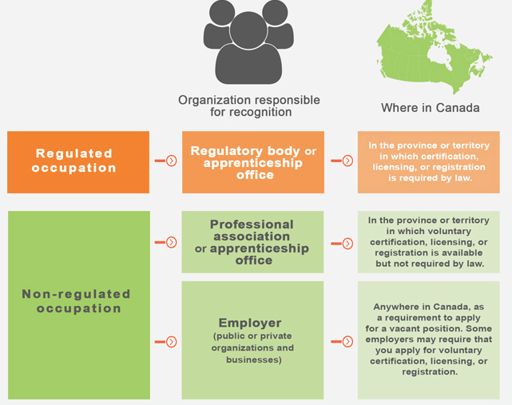
Nonregulated Professions & Occupations
People who work within nonregulated occupations do not have federal or provincial legislations governing their occupations.
Like regulated professions, many nonregulated occupations have professional organizations or bodies that award certification when a person completes a set of written or practical examinations or both

Slide 12


Vision
To promote transparent, objective, impartial and fair administrative processes and decision-making by the regulated health professions in British Columbia that protects the public interest and engenders public confidence in the provincial health care system.
http://www.hprb.gov.bc.ca/about.stm

Slide 13
Mission
To provide the public with independent, transparent and respectful review and early resolution processes that determine or resolve the health professions issues under review in an unbiased, timely and cost-effective manner.
To evaluate the effectiveness and efficiency of the review and dispute resolution processes of the self-governing colleges and, where warranted, recommend improvements.

Slide 14
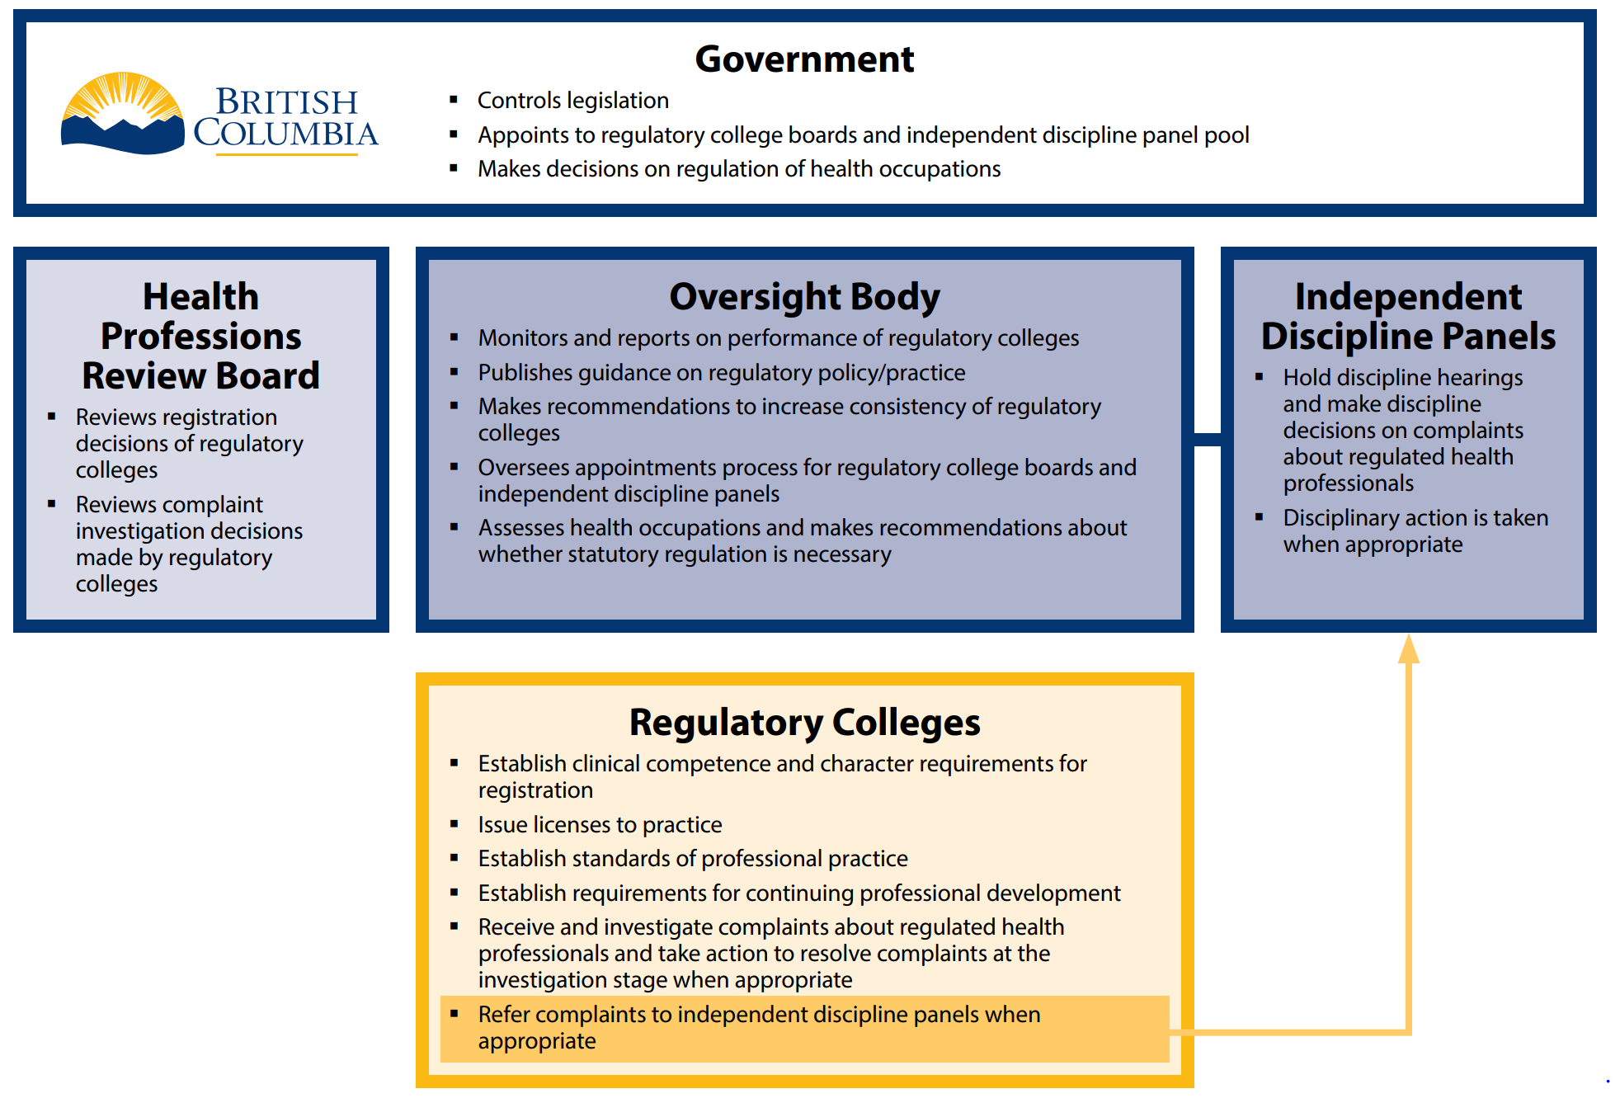
Modernized Regulatory Framework – Overview of Key Responsibilities

Slide 15

Who?
Who delivers health care and where it is delivered are undergoing continual change
Health care in Canada is provided by a wide variety of health care providers:
Conventional (or mainstream) medical practitioners
Those who practice complementary and alternative medicine
Informal workers:
Volunteers of community organizations
Friends and family members

Slide 16
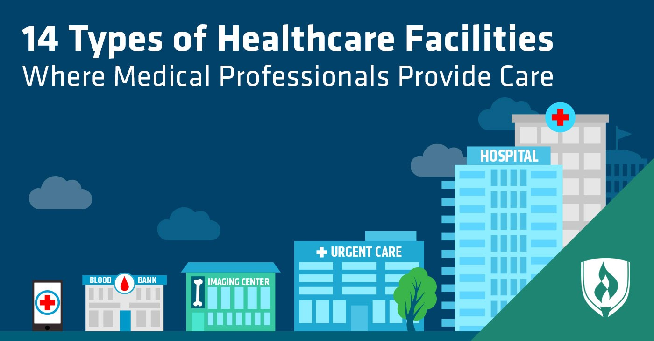
Where?
Practice settings include:
Hospitals
Residential care facilities
Rehabilitation centres
Community care facilities
Hospices
A variety of clinics, offices
Primary care settings
Home
Health centres on military bases

Slide 17
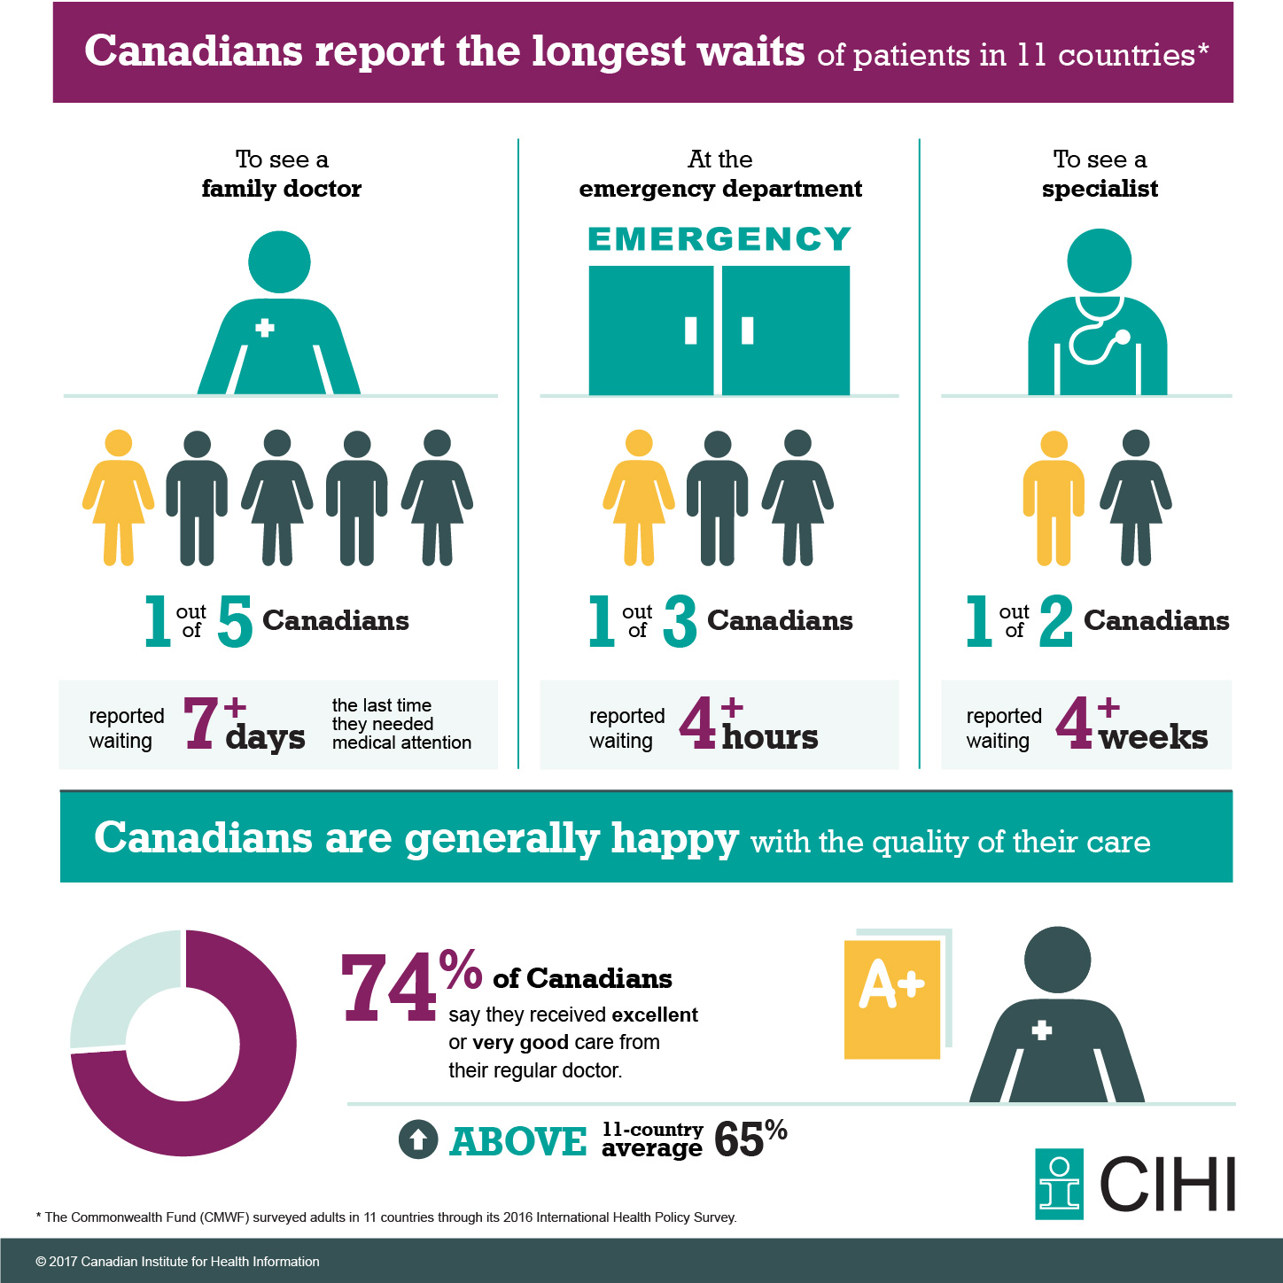

Slide 18
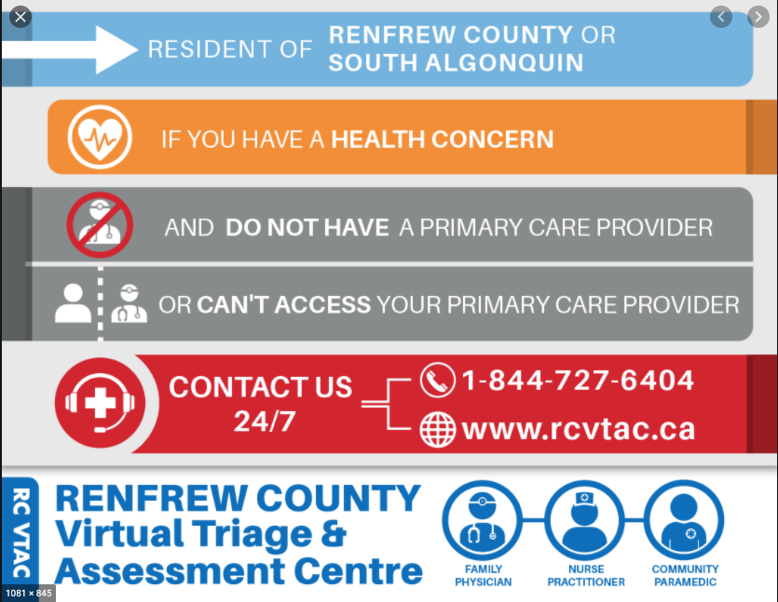
Trends in Health Care Delivery
In 2019, Statistics Canada reported that 4.5 million Canadians 12 & over, 14.5% of the population, did not have a family physician.
To address the issue, all regions are experimenting with different ways to deliver primary care:
Patient’s Medical Home (PMH)
Interprofessional collaboration
Community-based care
Primary Care Networks

Slide 19
Trends in health care delivery
Gender: 2019 data indicate that significantly more males (17.4%) than females (11.7%) reported they were without a regular health care provider.
Age group trends: Compared to all age groups, those aged 18 to 34 were most likely to be without a regular health care provider. Canadians aged 65 and older were the least likely to be without a provider.
Provincial variation: Compared to the national average (14.5%), Quebec (21.5%), Saskatchewan (17.2%) and British Columbia (17.7%) all had a higher proportion of residents without a regular health care provider. New Brunswick (10.2%) and Ontario (9.4%) both had a lower proportion of residents who did not have a regular health care provider, and all other provinces had a rate that was similar to the national average.
The most common reasons given for not having a provider: No one available in the area or no one in the area was taking new patients; Felt they did not need one but had a usual place of care, or have not tried to find one; Had one who left or retired.
Primary health care providers, 2019 (statcan.gc.ca)

Slide 20
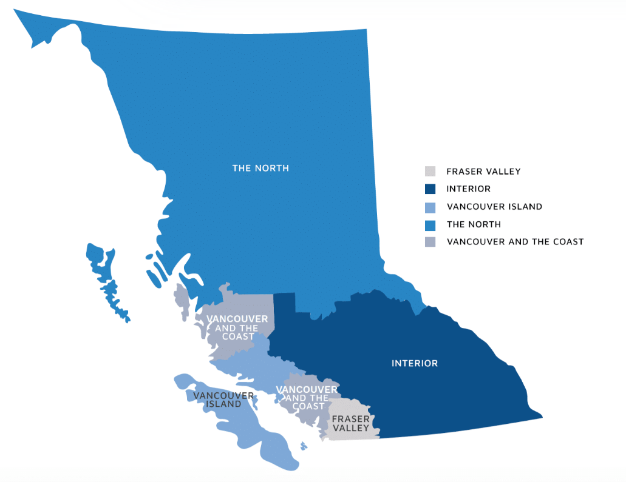
BC Primary Care Network
Who is part of the team
Family Practitioners
Nurse Practitioners
Registered Nurses
Physiotherapists
Clinical Pharmacists
Occupational Therapists
Medical Lab Technologists
MRI Technologists
Social Workers
Registered Dieticians
First Nation resources and Traditional Healers

Slide 21

Categories of Health Care Providers
Conventional health care providers include:
Physicians, nurse practitioners, midwives, nurses, dentists
Allied health professionals include
Dental hygienists, dietitians, optometrists, psychologists
Complementary and alternative practitioners include:
Indigenous healers, naturopathic doctors, massage therapists

Slide 22

Conventional Medicine
Conventional medicine is frequently referred to as orthodox, mainstream, traditional, or Western medicine.
Conventional health care practitioners diagnose health problems; treat pre-diagnosed health problems; and render technical, therapeutic, or supportive care with scientifically proven therapies, medication, and surgery.

Slide 23

Complementary and Alternative Medicine (CAM)
Complementary medicine supports conventional medicine, whereas alternative medicine provides another option to conventional medicine.
What is considered alternative and what is considered complementary is somewhat fluid and subjective.
What is considered standard treatment in one country or even in one province or territory may not be in another.
Most CAM therapies are not covered by provincial and territorial insurance plans.

Slide 24
Alternative Medicine
Critics of alternative medicine believe that treatments should be scientifically proven before they are used (also called an evidence-informed or evidence-based approach).
A significant number of Canadians use CAM at some point in their lives. This may be due to many factors, including:
disillusionment with conventional treatment
difficulty getting appointments with their doctor
cultural influences and belief systems that contradict mainstream medicine
information available on the Internet
many more people are actively participating in their own health care and treatment options.

Slide 25

Chiropractic: Conventional, Complementary, or Alternative?
Chiropractors (doctors of chiropractic medicine)
Diagnose and treat a wide range of conditions that deal primarily with disorders of the spine, pelvis, extremities, and joints, and the resulting effects on the central nervous system
Take a holistic approach to patient care
Use various noninvasive therapies
Chiropractic medicine is still considered by many to be on the cusp of alternative medicine.
The relationship between chiropractors and physicians is variable.

Slide 26

Physicians
Would-be physicians must complete 2 to 4 years of undergraduate work and then write the Medical College Admission Test (MCAT) before applying for placement in one of Canada’s medical schools.
Medical school consists of 3 to 4 years of study, followed by a residency in the person’s area of specialty.

Slide 27
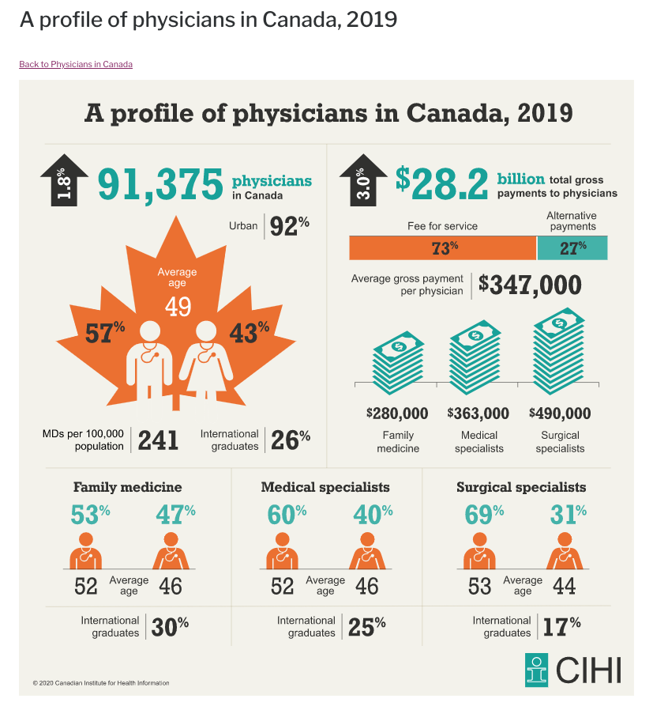
Select Physician Specialties in Canada
Family Physicians
Emergentologists
Geriatricians
Cardiologists
Gynecologists and Obstetricians
Internists and Hospitalists
Neurologists
Ophthalmologists
Oncologists
Psychiatrists
Physiatrists
Radiologists
Respirologists
Surgeons

Slide 28
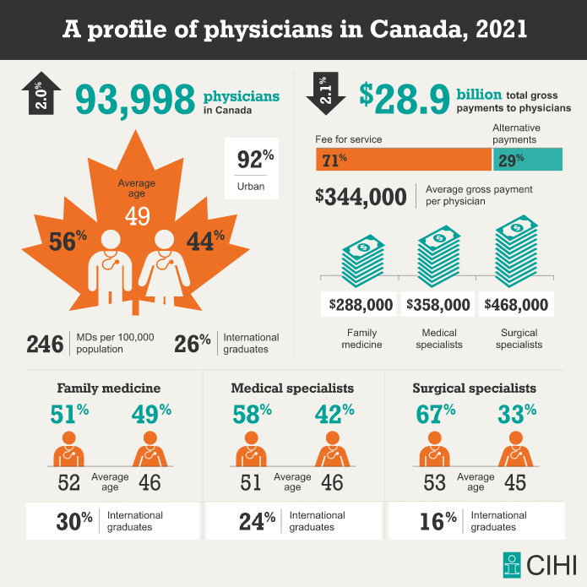
Canadian Institute for Health Information. A profile of physicians in Canada

Slide 29
A profile of physicians in Canada, 2021: Synopsis
Average age: 49
56 % identify as Male, 44% Female
92% in urban settings
26% international graduates
71% fee-for-service payments, 29% alternative payments. This is soon to change in BC, recently providing an attractive option to fee-for-service (payments to reflect time on the job, including administrative responsibilities, not only number of patient visits).
Average income (gross payment per physician): $344,000
Family medicine: $ 288,000
Medical specialists: 358,000
Surgical specialists: 468,000

Slide 30
Human health resources
Physicians and nurses are the regulated professionals that account for the largest functional output.
Physicians are paid through several formulas.
Gross pay (without deductions) made for clinical services
Physicians are paid by provinces and territories for insured medical services, the majority for consultations and physician visits
Fee for Service: This is the predominant method. 70-73% of total clinical payments to doctors are by provinces and territories.

Slide 31
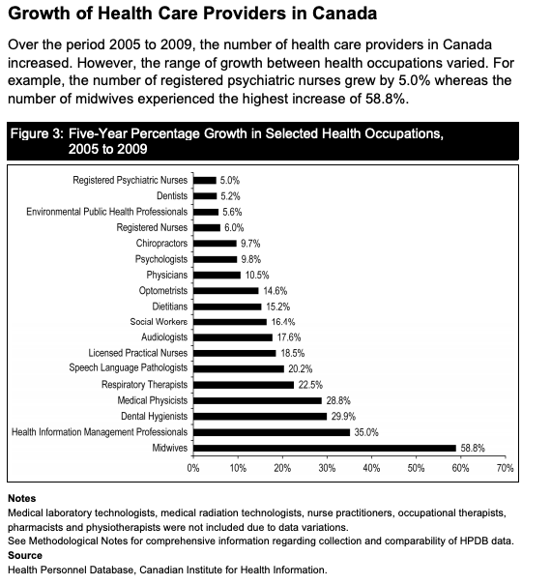

https://secure.cihi.ca/free_products/CanadasHealthCareProviders2000to2009AReferenceGuide_EN.pdf

Slide 32
Human health resources
Fee for service
Physicians charge the provincial and territorial governments for every service they perform, and relates to the complexity and length of patient visit.
Several main categories of visit fees:
A minor assessment
Intermediate assessment
Full assessment – physical examination
Can bill for home visits, giving an injection, suturing a wound, and hospital visits.

Slide 33
Human health resources
Capitation / population based funding
Physicians are paid through this model for each registered patient in their practice.
Usually paid monthly with capitation-based fund, a set amount for each patient that is determined by age and health care needs.
Receives the same amount whether a patient visits once or 30 times per year.
Doctors are paid extra for achieving certain milestones (e.g., immunization rates).
Payments are based on a given group of registered patients, the foundation of practice. Receives a guaranteed income based on defined population.
There may be incentives for doctors who integrate disease prevention and health promotion.

Slide 34
Human health resources
Indirect capitation: A funding model through which an organization such as a regional health authority receives a set amount of money to manage health care. Includes staff, services, administrative costs, capitol expenditures and other employees.
Global budget: For doctors practicing in under-served areas; paid a fee for maintaining the practice, including vacation and educational leave.
Salary and contract: Receive a negotiated amount of money per time frame (usually a month). Paid by contract if hired by a hospital or clinic for a specific task and time frame.
Blended funding: Most doctors who engage in FFS also partake in another form of payment.
Specialist compensation: In teaching hospitals, specialists who have teaching responsibilities are paid extra. Most are on a salary and also maintain a private practice. Specialists not employed by a hospital rely on FFS and bill provinces and territories directly.

Slide 35
Doctor payment structures: A new alternative for BC
In BC it is estimated that one million people, about one fifth of the province’s population, do not have a family doctor. This is the case for 100,000 people on Vancouver Island alone.
A new, family physician payment model was negotiated in 2022 to recruit and retain family physicians.
The new model is offered as an alternative to the traditional fee-for-service model that has focused on the number of patient visits, not taking into account time spent on the ever increasing administrative demands.
The new model offers compensation for doctors to see patients for longer, taking into account all hours worked and tasks completed.
The hope is that there will be increased recruitment and retention of family doctors; this in turn will reduce pressure on urgent and primary care centres, walk-in clinics and Emergency departments.

Slide 36
Health workforce trends in Canada
The Canadian Institutes for Health Research (CIHI) collects supply and demographic data on more than 30 different groups of health care professionals. The following findings, from Health Workforce in Canada, 2017 to 2021: Overview, reflect the most recent information available from the 2020–2021 data cycle.
The supply for some health care professional groups declined between 2020 and 2021, including health information management professionals (-18.8%), genetic counsellors (-11.1%) and medical laboratory technologists (-0.6%).
Other professions saw an increase in supply. The fastest-growing groups of health care professionals in 2021 were physician assistants (17.9%), nurse practitioners (10.7%) and social workers (7.5%).
Paramedics and dental hygienists were more likely to be younger compared with other health care professionals — more than 1 in 5 were younger than age 30. By contrast, about 1 in 4 psychologists and physicians were 60 and older.
Women continue to play a vital role in the health workforce, comprising more than 97% of the supply of midwives, dental assistants and dental hygienists.
Men represented the majority of the supply for paramedics (63.5%) and chiropractors (60%).

Slide 37

Registered Nurses
All Canadian jurisdictions except Quebec require bachelor degrees in nursing to enter the profession.
The RN usually assumes the most complex components of nursing care, and also a variety of leadership roles both clinical and administrative.
Many hospitals and other facilities employ RNs only in specific areas, such as intensive care units, where their specific skill sets, particularly in assessment and decision making, are critical.

Slide 38
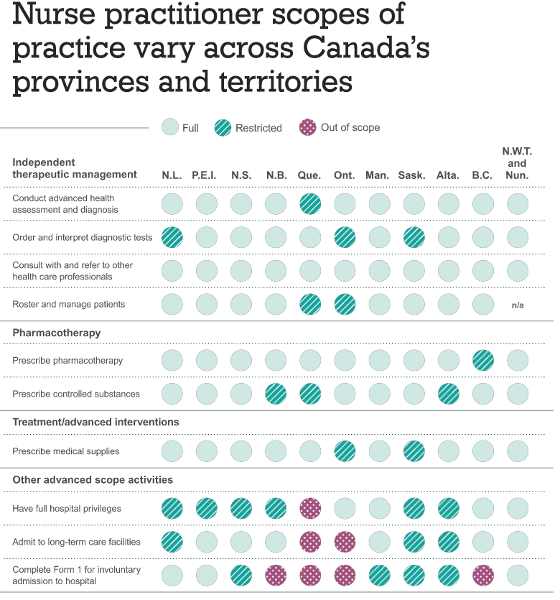
Advanced Practice Nurse
There are two categories of advanced practice nurses:
Nurse practitioners (NPs) are registered nurses with advanced training and skills, authorizing them to practise in an expanded role with many of the skills and responsibilities formerly relegated to primary care physicians (e.g., prescribing medications).
Clinical Nurse Specialists are nurses who have a master’s or doctoral degree in nursing in addition to wide-ranging nursing knowledge and clinical experience in a specialty area

Slide 39
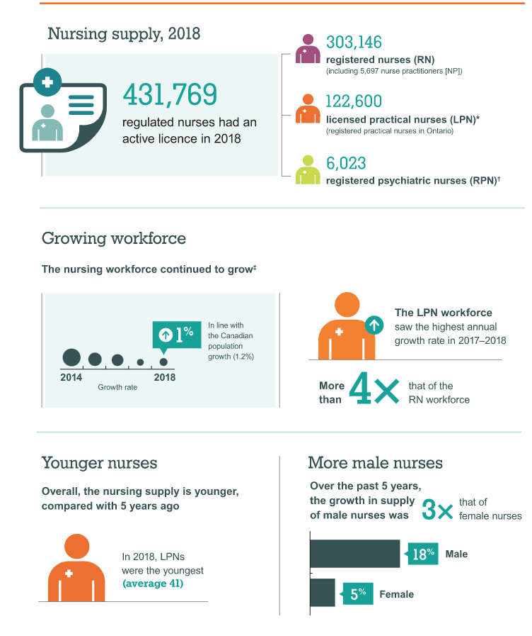
Licensed Practical Nurses
Licensed practical nurses (LPNs) – called registered practical nurses (RPN) in Ontario – have completed a 2-year diploma program at a community or private college and a standard examination.
The skill set and scope of practice of LPNs have expanded dramatically over the past few years, assuming many of the responsibilities formerly limited to RNs.
The practical nurse collaborates with RNs and other members of the health care team to render patient care
https://www.cihi.ca/en/a-profile-of-nursing-in-canada

Slide 40
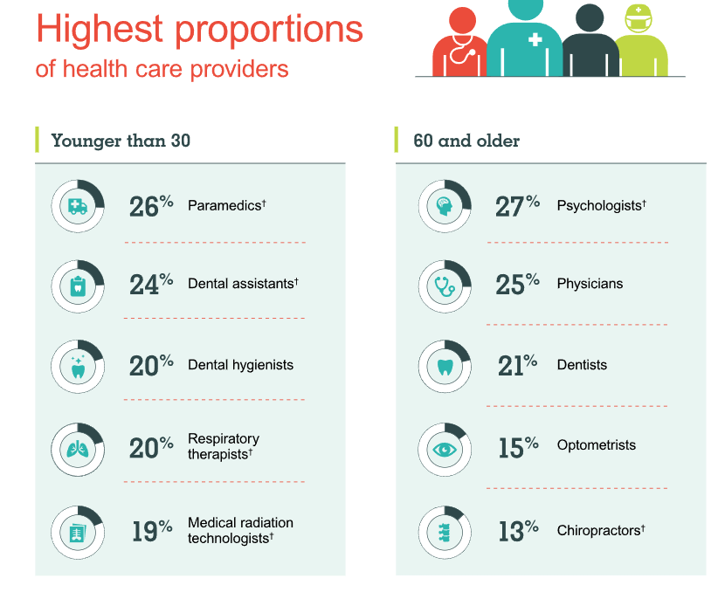

A profile of health care providers in Canada, 2020

Slide 41
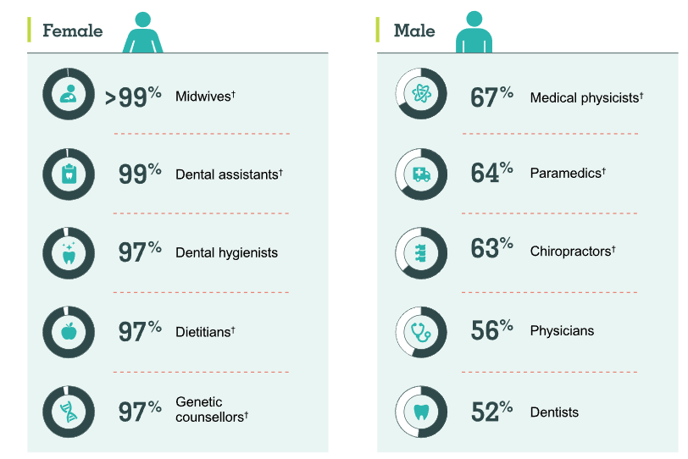

A profile of health care providers in Canada, 2020

Slide 42

Pharmacists
Licensed pharmacists dispense medications in response to prescriptions.
To practise pharmacy, a person must earn a bachelor’s degree in pharmacy, complete an internship, and successfully pass a national board examination.
Many jurisdictions allow pharmacists to write prescriptions under designated guidelines.
The goal of adding new responsibilities to the scope of practice for the pharmacist is to reduce the volume of work for doctors, clinics, and emergency departments and increase patient access to front-line services.

Slide 43

College of Pharmacists of British Columbia
Our job is to protect public health by licensing and regulating pharmacists and pharmacy technicians and the pharmacies where they practice. We are responsible for making sure every pharmacist and pharmacy technician in BC is fully qualified and able to provide the public with safe and ethical pharmacy care.
The College receives its authority from - and is responsible for administering - provincial pharmacy legislation.

Slide 44
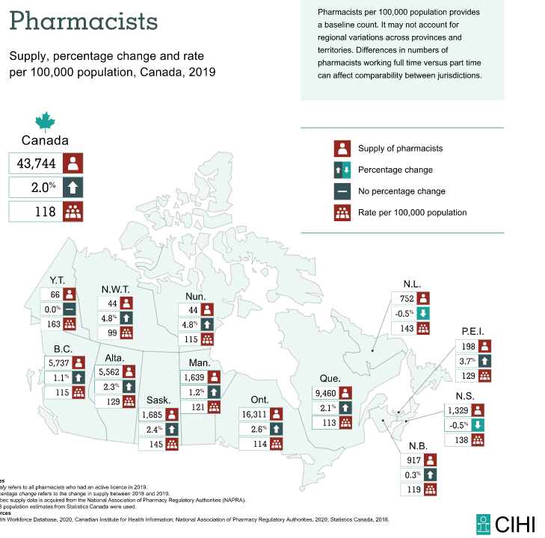

Slide 45

Pharmacy Technicians
Pharmacy technicians are health care professionals who help pharmacists maintain inventories of medications and prescription records of pharmaceutical products; ensure that the information on prescriptions is accurate; enter client information in databases and prepare medications for clients; compound oral solutions, ointments and creams; bill third-party insurance; and may help with scheduling and flow.
Pharmacy technicians work at retail and hospital pharmacies, long-term care facilities and pharmaceutical manufacturers.

Slide 46

Midwives
The Midwifery Education Program at UBC is a CMBC approved four-year, direct entry, full-time undergraduate program leading to a Bachelor of Midwifery degree. Graduates may apply for general registration in British Columbia after passing the Canadian Midwifery Registration Examination (CMRE).
Midwives who have been educated in an approved midwifery program in or outside of British Columbia must seek registration with the College of Midwives of British Columbia (CMBC).

Slide 47

Midwives
Midwives
Provide prenatal care (before the baby’s birth)
Deliver the baby (either at the patient’s home, in a a birthing centre, or in the hospital)
Provide newborn care for up to 6 weeks after the birth
The care of a pregnant woman must be turned over to a physician if
The pregnancy becomes high risk
Shows signs of other problems during any phase of the pregnancy, labour or delivery
http://www.perinatalservicesbc.ca/Documents/Data-Surveillance/Reports/SurveillanceSpecialReportsMidwiferyReport2008.pdf

Slide 48
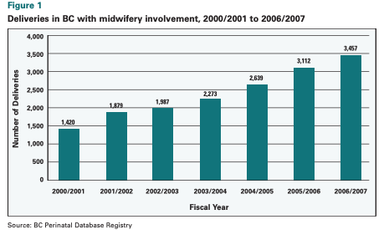
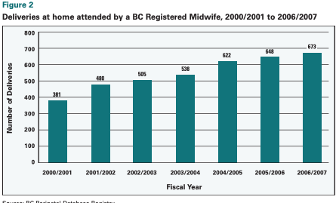
42, 573 deliveries in BC in 2021
http://www.perinatalservicesbc.ca/Documents/Data-Surveillance/Reports/SurveillanceSpecialReportsMidwiferyReport2008.pdf

Slide 49
Optometrists and Opticians
Optometrists (doctors of optometry) are licensed to
Assess eye function and conditions
Prescribe selected medications to treat eye conditions
Prescribe glasses and contact lenses
Opticians
Fill prescriptions for eyeglasses or contact lenses
Fit glasses and help patients select frames
Provide instruction related to contact lenses and glasses
Doctors of optometry require seven to eight years of post-secondary education to obtain their professional designation, Doctor of Optometry (OD).
There are two schools of optometry located in Canada:
University of Waterloo
Université de Montréal

Slide 50
Osteopathic Physicians
Osteopathy incorporates a holistic, manual approach to the diagnosis and treatment of disease. It considers the musculoskeletal system and its relationship with the rest of the body in terms of self-healing, self-regulating capabilities
Osteopathic physicians are trained in the United States, Europe, Canada
In Canada, osteopathy remains a nonregulated profession. Graduates of osteopathy schools can practise as osteopathic manual practitioners or therapists.
Like doctors who have an MD (Medical Doctor) degree, DOs must pass a medical board exam to obtain a licence and enter practice. DOs must also register through the medical licensing council and either the College of Family Physicians (CFP) or the Royal College of Physicians and Surgeons of Canada (RCPSC).

Slide 51

Osteopathy
Osteopathy emphasizes the interrelationship between structure and function of the human body. It follows a belief in the body’s ability to self-heal and self-regulate. Osteopathic practitioners don’t see themselves as healers, but instead as facilitators to health.

Slide 52
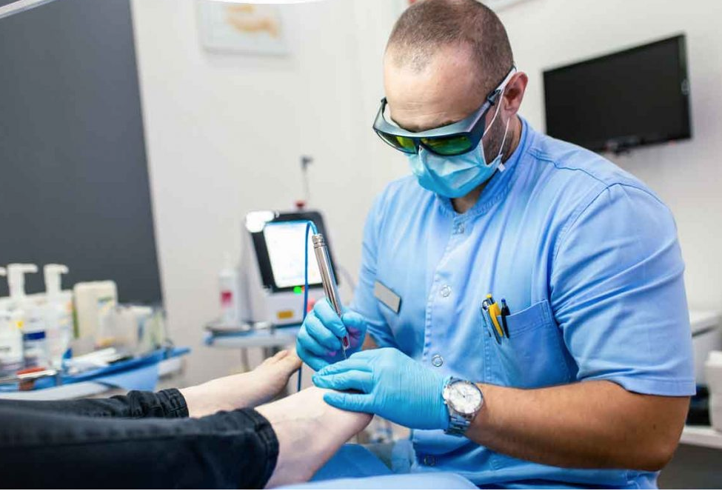
Podiatrists (Chiropodists)
Podiatrists specialize in the diagnosis, assessment, and treatment of foot disorders, such as
Sports injuries
Foot deformities
Infections
General foot conditions, including calluses, corns, ingrown toenails, and warts
In Canada, the chiropody/podiatry program is offered only at the Michener Institute in Toronto

Slide 53
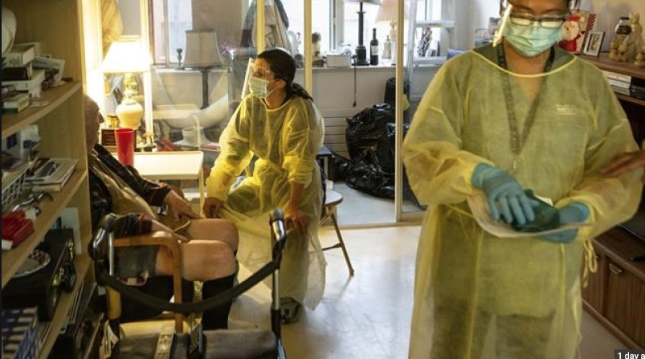
Personal Support Workers
Most jurisdictions recognize a category of health care workers who provide basic care and carry out auxiliary duty for patients. The title and educational requirements vary.
These health care providers work under the direction of other members of the health care team in:
long-term care facilities
home care organizations
adult day care programs
seniors’ residences
group homes
Personal support worker (PSW)
Health care aide (HCA)
Health care assistant
Continuing care assistant (CCA)
Health care support worker
Home care support worker
Resident care aide
Orderly
Health care attendant
Patient services associate

Slide 54
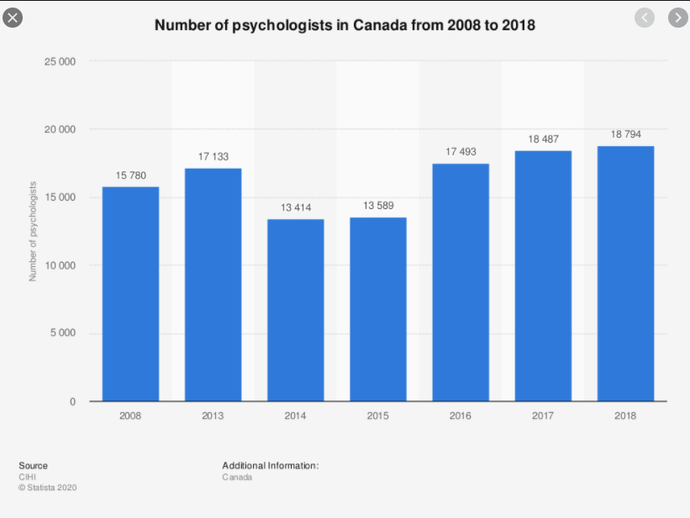
Psychologists
Psychologists work with individuals and families to treat emotional and mental disorders, mainly through counselling.
Psychologists do not have the authority to prescribe medications, perform medical procedures, or order lab or diagnostic tests.
Often a psychiatrist and a psychologist will work as a team.

Slide 55
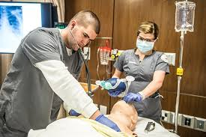
Respiratory Therapists
Respiratory therapist (RT) college programs are three years in length, and university programs, four.
RTs, specialists in caring for people with breathing difficulties may:
Manage advanced life support for patients on respirators
Intubate patients
Initiate the use of respirators
Perform diagnostic testing
Set up oxygen therapy or inhalation treatments

Slide 56

Physiotherapists
Physiotherapists are regulated health professionals who work with patients in a variety of settings to
Limit and improve physical impairments and disabilities
Prevent and manage pain
Most jurisdictions cover physiotherapy services under specific conditions and for limited time frames

Slide 57

Occupational Therapists
Occupational therapists (OTs) work in a variety of settings to help people learn or relearn to manage important everyday activities.
OTs work with patients who have difficulties as the result of
Accident
Disability
Disease
Emotional or developmental problems
Aging

Slide 58

Laboratory and Diagnostic Services
The field of medicine depends greatly on laboratory and diagnostic services.
Many diagnoses cannot be confirmed without a lab or diagnostic test of some sort.
Highly qualified individuals, including physician specialists and technicians and technologists specialists, populate this field.
Many specialties exist within this area, most of which are regulated in their individual province or territory.

Slide 59

Volunteer Caregivers
Friends, family, and volunteer caregivers (who work in partnership with professional caregivers) provide tremendous support to those who are ill.
With current shortages in all categories of health care professionals, many patients depend on volunteers to fill in the gaps in their care.
The hours of care provided by these individuals are uncountable, the output unequalled, and the stress phenomenal.
Many ill people could not manage without this supportive network.

Slide 60

Support received by caregivers in Canada
A large number of Canadians provide care or help to family members or friends who have a long-term health condition or disability
In 2018, one-quarter of Canadians aged 15 and older reported they had, in the past year, cared for or helped someone who had a long-term health condition or a physical or mental disability, or someone who had problems related to aging

Slide 61
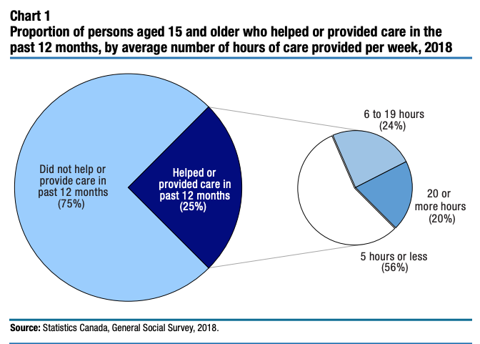
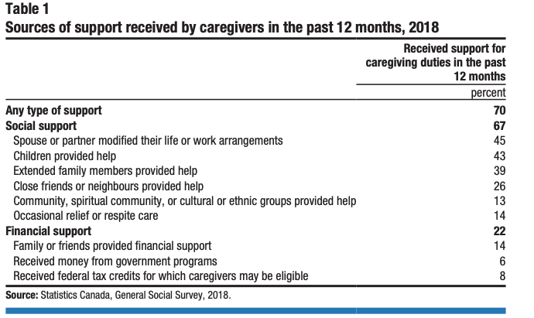
One‑quarter of Canadians provided care in the past year, and 7 in 10 caregivers received some form of support

Slide 62
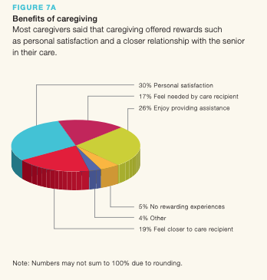
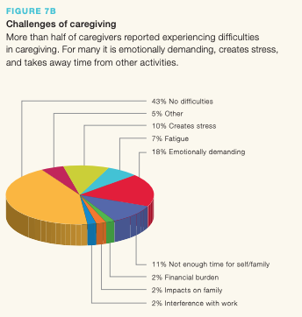

Slide 63

Practice Settings (1 of 3)
The need for home and community care is increasing for several reasons
The objective is to reduce or avoid time in hospital and delay or avoid admission to long-term care facilities
Home care is provided for individuals with a variety of health issues including acute or chronic illnesses, complex heath needs, palliative care, respite, or rehabilitative care.

Slide 64

Practice Settings (2 of 3)
Urgent care and walk-in clinics provide nonemergency medical care to people.
Ambulatory care encompasses several different types of facilities, including clinics, day surgeries and emergency rooms.
Outpatient clinics offer services to meet the unique needs of a particular area.
Mental health clinics respond to the specific needs of individuals with mental health disorders

Slide 65
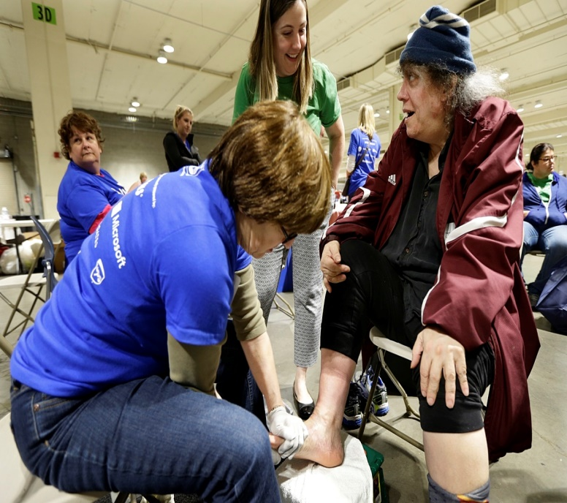
Practice Settings (3 of 3)
Harm reduction sites or clinics are guided by strategies, practices, and procedures that reduce the harm to individuals caused by substance misuse and addiction.
Methadone clinics treat individuals addicted to opioid drugs
Nurse Practitioner-Led clinics provide care for individuals who do not have access to a primary care provider or primary health care team

Slide 66

Why Clinics Make Sense
Clinics have the following benefits:
Cost-effectiveness
Timely access, fewer patient visits, convenience
Patient focus

Slide 67

Primary Health Care: Issues and Trends (1 of 2)
Thousands of Canadians do not have a primary care provider and those that do may find getting an appointment in a timely manner is difficult
Strategies to facilitate same-day access include:
The use of multidisciplinary teams
Extended office or after office hours clinics
The use of email and other communication technologies

Slide 68

Primary Health Care: Issues and Trends (2 of 2)
Canada has invested heavily in primary health care reform initiatives
Primary health care groups
Are groups of health care professionals who work together as an interdisciplinary team
Apply to provincial or territorial governments for approval and provision of funds
May require a certain percentage of patients agree to become part of the practice; this is called rostering

Slide 69
Health centres in Canadian Forces bases
Canadian Forces Health Services Centre Ottawa - Canada.ca
The Canadian Forces Health Services Group is an independent health jurisdiction and system. The team supports the Canadian defence strategy by offering a patient-focused comprehensive spectrum of care in evidence-based health services. Its mission is to provide full spectrum, high quality health services to Canada's fighting forces wherever they serve. The mandate is three-fold:
1. Deliver High Quality Health Care
2. Provide a Deployable Health Capability
3. Provide Health Services Advice
The obligation is to maintain members’ health and mental well-being, to prevent disease, to diagnose and treat injury, illness, or disability, and to facilitate rapid return to operational fitness.
There are 33 Canadian Armed Forces (CAF) clinics across the country whose role it is to provide health services to CAF members. Major health centres in western Canada include CFB Edmonton and CFB Cold Lake in Alberta, and CFB Esquimalt and CFB Comox in BC.

Slide 70
Health centres in Canadian Forces bases: Personnel
Personnel comprise over 40 health occupations.
For military personnel, most health training and education takes place at CFB Borden, Ontario for the following: Medical Technicians, Dental Technicians, Preventive Medicine Technicians, Physician Assistants, Nurses, Dentists, Physicians, Healthcare administrators, Health Services Operations Officers, and Biological Science Officers.
Civilian-Military Co-operation:
To fulfill its mandate of providing comprehensive health services to CAF personnel across Canada and abroad, the group is supported by a wide variety of Canadian civilian provincial and federal health agencies.
Services are integrated within the mainstream of the national and provincial/territorial health systems through strategic alliances, memoranda of understanding and local arrangements.
The complete CAF health system, which has relied on an electronic health records system for over fifteen years, has been accredited by Accreditation Canada.

Slide 71
Health centres in Canadian Forces bases: Mental Health services
Mental health services in the CAF have especially developed over the past twenty years.
Health centres include mental health nurses, social workers, psychiatrists, psychologists, addictions counsellors and some chaplains who have specialized mental health training as well.
There is typically a mix of military and civilian personnel working together. Civilian personnel are either federal government employees (through the Department of National Defense) or independent contractors (through Calian Group Ltd.).
Staffing is multidisciplinary but sufficient personnel is often a challenge; therefore care is sometimes outsourced to qualified community practitioners on designated provider lists.
With greater acceptance of mental health assistance, demand has risen considerably.
Communication about assessments, counselling and treatment is with the member’s M.O. (Medical Officer), usually a physician, nurse practitioner or physician assistant and limited only to personnel on the individual’s health care team. Any communication about the nature of medical or mental health information with others (such as those in the member’s chain of command, who only have a right to know scheduling of medical appointments and what any medical limitations are), is considered a serious breach.

Slide 72
The Mental Health Continuum
The Mental Health Continuum is a tool that was developed by the Canadian Armed Forces Health Services in collaboration with the U.S. Marine Corps Department of Psychiatry.
The Continuum uses behaviours rather than symptoms to help one become more aware of changes that are readily observable in day-to-day activities in the workplace.
The Continuum goes from:
Green: health, adaptive coping , through
Yellow: mild and reversible distress or functional impairment , to
Orange: more severe, persistent injury or impairment, to
Red: clinical illnesses and disorders requiring more concentrated medical care.

Slide 73
Mental Health Continuum
When looking at the Continuum, it is important to remember to pay attention to how we cope and deal with stressors when we are healthy (in the green zone) so that we will be able to recognize when our well-being diminishes (the yellow or orange zones).
CAF members are encouraged to keep a copy of the Continuum nearby as a reminder of the importance of mental health, by periodically checking-in with oneself and others and asking, “Am I living in the green?”
Sometimes members decide on their own to seek mental health assistance, not always relying on referrals from doctors or the urging of others, when they look at the Continuum and realize they’re in the ‘orange’ or the ‘red’.
An example of the Continuum is shown on the next slide.

Slide 74
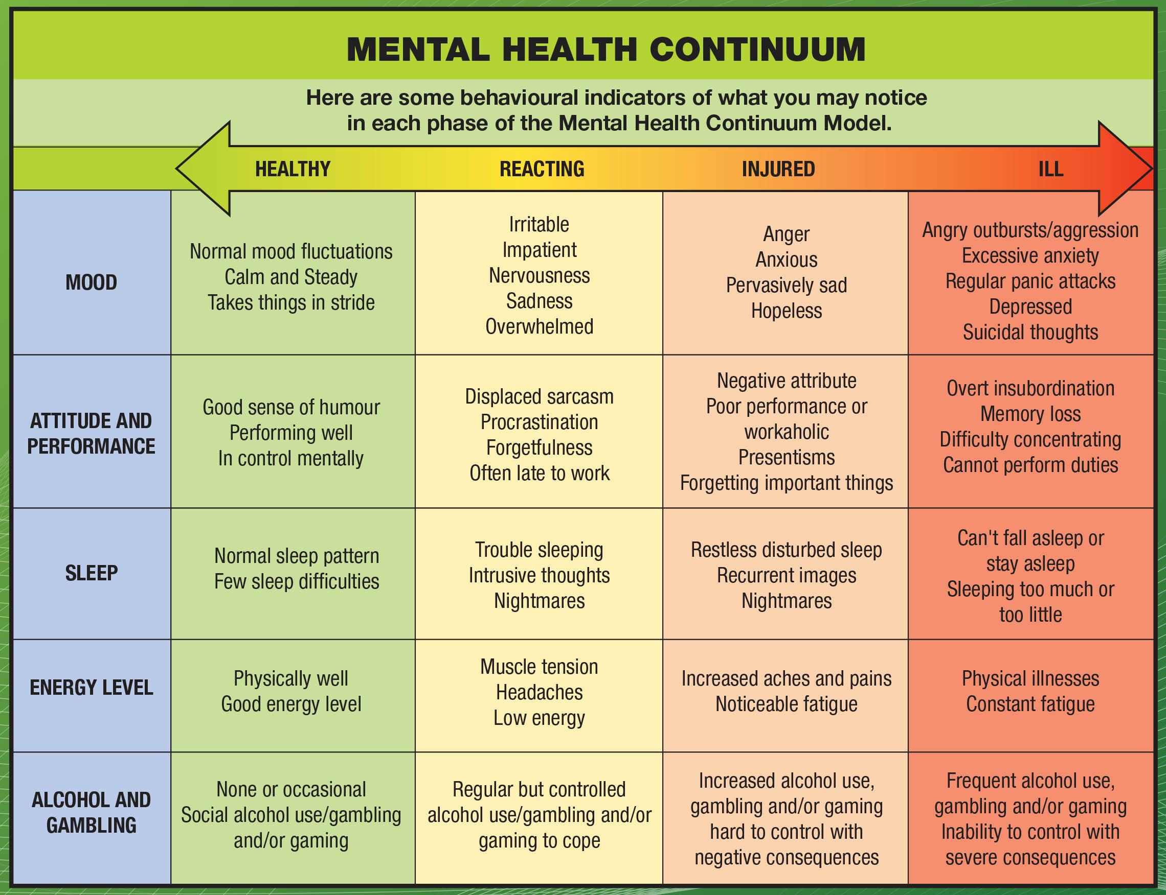

Slide 75

Health Office Administration
People in this role must have a sound knowledge base in pharmacology, diagnostic and laboratory testing, medical terminology, anatomy and physiology, pathophysiology, and the principles of triage.
Practice settings include doctors’ offices and group practices, specialists’ offices, all hospital units, and long-term care facilities.
Administrators must have the ability to multitask and to work efficiently under pressure and must be flexible, friendly, empathetic, supportive, and comfortable around individuals experiencing health problems.

Slide 76

Health Information Management
Health Information Management (HIM) professionals hold the designation of CHIM—Certified in Health Information Management.
The HIM profession has four domains of practice:
data quality
e-HIM—electronic health information management
privacy
HIM standards

Slide 77
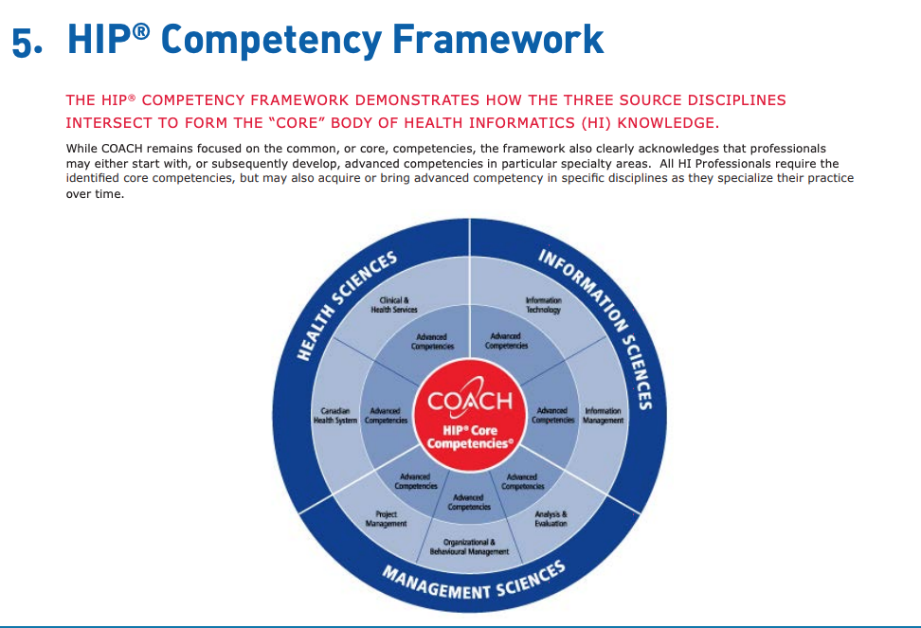
Six core competency areas
Biomedical sciences
Health care systems in Canada
Health information
Information systems and technology
Management aspects
Ethics and professional practice
https://digitalhealthcanada.com/wp-content/uploads/2019/07/Health-Informatics-Core-Competencies.pdf

Slide 78
Practice settings for HIM professionals
HIM professionals are employed in a variety of health care settings including acute care, community health clinics, mental health and outreach programs, nursing homes and long-term care facilities, as well as government agencies, privacy commissioner’s offices, educational institutions, pharmaceutical companies and workers’ compensation offices.
HIM professionals work in the areas of health records, health information management, decision support, privacy, quality management, research and statistics, information systems, utilization management and risk management.
There are no legislated regulatory requirements for HIM professionals in Canada at the moment. Many employers require certification with the Canadian Health Information Management Association (CHIMA) as a condition of employment.
https://secure.cihi.ca/free_products/CanadasHealthCareProviders2000to2009AReferenceGuide_EN.pdf

Slide 79
NEW DEVELOPMENTS Federal Health Transfer - 2023
Premier Justin Trudeau lays out new Federal Health Transfer plan.
Provinces and territories to receive 196 billion dollars over the next 10 years.
One fourth of that is money not previously promised.
17 billion dollars over 10 years is above previously planned increases.
25 billion dollars is for target populations for family doctors, mental health, surgical backlogs, and health data systems.
Although appreciated, these funds will increase the federal share of health care funding to only 24%, falling short of the 35% expected by the provinces and territories.
The provinces/territories will also receive 1.7 billion dollars over 5 years, to increase wages for personal support workers in long term care.

Slide 80
Federal Health Transfer
A separate, 2 billion dollar fund is offered for Indigenous health care needs.
Trudeau stated that this money will be flexible in order to meet specific provincial/territorial circumstances.
Targeted funding for priorities will be delivered through one-to-one negotiated deals with each provincial/territorial jurisdiction to take place within weeks.
Initial response from the BC Premier, David Eby: Although appreciative for increased funding, the proposal is fiscally limited. It does provide a foundation and reassurance that important discussions are moving forward on talks about how health care is delivered to Canadians.
The Ontario Premier, Doug Ford, stated that he won’t decline the funds but it’s only the beginning; this is a start, a down payment on further discussions.
Many others are disappointed, commenting that the funding falls far short of what’s needed, and assert that funding alone will not solve the primary care crisis.

Slide 81
Feds want health care data
Federal Health Minister Yves Duclos states (2023) that better health data saves lives.
The Canada Health Transfer offer is contingent on provinces/territories bringing their health care data collection into the 21st century.
Canada has limited data to help understand where the weak points are in the health system or what is needed now and in the future.
Digital patient records that can be easily shared between jurisdictions or health care providers are also a federal demand.

Slide 82
Primary health care in crisis
Discussions began in 2016. In 2020, premiers began asking Trudeau for meetings to overhaul the health transfers.
These meetings were delayed until Covid-19 was no longer a crisis.
In 2022, the health care system was seen to be in crisis: thousands of backlogged surgeries, a burnt-out and understaffed health care workforce, and emergency rooms that could not keep pace with the demand.
The premiers have been trying to stay united since the 2016 talks broke down.
Manitoba Premier Heather Stefanson commented that the federal government had the provinces’ proposal for 2.5 years and we have had the new federal proposal for 2.5 hours; we’re going to have to really see what the details mean.

Slide 83
Primary care challenges
Wait times demonstrate struggles across the country to provide adequate care (for doctor visits in clinics, Emergency wait times and for surgery).
MediMap, a wait time index launched in 2016 by UVic graduates Blake Adams and Jonathan Clark, operates in BC, Alberta, Saskatchewan, Manitoba, Ontario and Nova Scotia. MediMap’s data reflects that walk-in clinic and doctor visits in Victoria is at the top of a national list for the longest wait times.
The average wait time in Victoria was 137 minutes per visit at walk-in clinics (2022).
The second highest is North Vancouver.
Richmond had the shortest wait time at an average of 31 minutes.
The average across the country in 2022 was 37 minutes.

Slide 84
Forum: Victoria Public System in Crisis – Feb. 7, 2023. Key points raised
We DO NOT have a universal health care system because we do not have equal accessibility and delivery.
The BC public demands better accountability through data: Where does the money go? What is the evidence that the allocations showed improved outcomes?
It was public awareness campaigns that pressured governments to listen and to respond to demands for reform.
New government funding initiative spurred by public: BC Health Care Matters campaign. ‘Get Involved’.
A grass-roots group founded by 1 mother from Langford (Camille Currie).
HOSTING AN ONLINE VIRTUAL TOWN HALL ON THE PRIMARY CARE CRISIS
Guest speaker: Dr. Vanessa Young; starts Thursday, Feb. 9, 2023, 6:30 p.m. Go to youtube.com/watch?v=tB-1PTdy7f0; ceharnett@timescolonist.com

Slide 85
Forum: key points
The new proposed funding reinforces the status quo, not reform. No concrete action on new procedures.
No talk of consequences or claw-back of funding for not adhering to guidelines of the Canada Health Act.
To date, only $3,000 in fines have been administered for not adhering to the CHA.
The funding allocated is not enough to cover the cost of a massive reboot of the system itself.
The cycle continues: Ask for more money to reinforce the status quo.
Ground-work for change is unlikely. Primary care needs structural changes.

Slide 86
Forum: possible solutions
Change mind set: Recognize the value of additional health care professionals in addition to doctors, and support new health care models.
Team-based care: Various health care professionals work together in one location. Integrate family doctors, social workers, mental health and addictions, infant care, etc. Helps to avoid burnout.
Nurse Practitioner clinics: In Victoria, serves 4,000 residents – offers primary care, assessments, diagnosis and referrals.
Mobile care teams: These began in Northern communities after funding cuts in the 1990s. Consist of doctors, nurses, physiotherapists, fitness trainers, nutritionists; doctor’s main role is consultant; primary care community nurses offer traveling for home visits, e.g. re older adults and resolve issues in the comfort of own home.
One doctor leading such a team has stated that without primary care, the system crumbles. Fees to his team’s patients for the program are $5,100 per year (paying $425 per month) which covers non-insured services.
A 2012 impact study showed a 35% reduction in hospital stays, 20% emergency visits, and 20% kept out of nursing homes. Yet, a proposal for government sharing costs was rejected.

Slide 87
Possible solutions
Think about other ways to deliver health care.
Hybrid systems: These are working and are universal, blending private and public, e.g., in Germany, France and Switzerland.
Virtual care, telehealth: These approaches work but not for all, as tech systems are not always available. A major positive development arising out of the pandemic was a substantial increase in use of virtual care and telehealth, expanding viable alternatives that often are feasible.
Physician Assistants (PAs): We have many PA teams that create solutions for less cost.
Holistic mental wellness centres: Walk-in clinics: assessments, referrals; if urgent need, care provided within 2 weeks.
Pharmacists: Can take on more responsibilities.
Community care model: Create a health care team within the community after initial assessment. Pair the patient with appropriate care professionals to match patient need in one location.

Slide 88
Activity: Restructuring Health Care
Our health care community has spoken clearly and loudly: Health care is NOT a political issue; rather, health care is a fundamental human right! Health care reform requires a fundamental shift in how we think about and envision health care.
Small-Groups Activity
Discussion – restructuring the primary care model. Proposal development and presentation.
First, reflect on the following questions:
What are your views on the new 2023 federal transfer proposal to the provinces/territories?
Will the allocated funding alone be enough to further improvements to our health care system?
What are the structural changes necessary to bring forth new health care reforms?

Slide 89
Activity
Your group, in-role, will function as provincial ministers responsible for primary care systems
reform. You have been granted substantial funding to prepare a primary care reform
proposal to be presented to the federal government. Ask yourselves:
What are the primary care needs of your provinces/territories?
What are the structural changes and concrete actions you recommend to bring forth positive change?
3. Devise a proposal brief to be presented to the federal government.

Slide 90
My imaginary reform
Changing how we define our health care systems: Move away from polarizing descriptions of private vs. public.
Recognize that private and public health care exist in tandem, and are effective in their own right.
Change the language used; re-define, reframe the labels. For example, what would or could occur if we changed the wording from ‘private’ to ‘complementary’ care?
Convince the federal government to distribute funds to both public and ‘complementary’ health care. We could then have a truly collaborative approach to solving health care problems together, as a unified group with the same aims of improving health care and access to all.
This would require fundamental power shifts to equitable arrangements, where different forms come together for the betterment of the whole.

